Slide 1
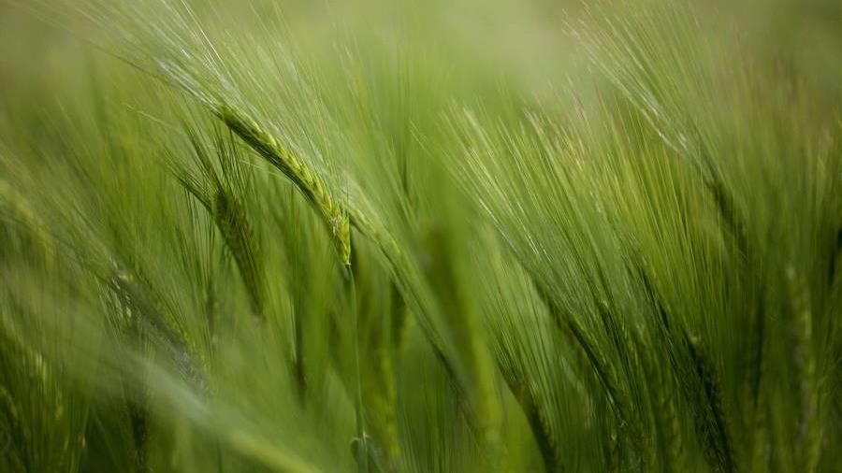
Self-regulation
With a focus on SEND

Slide 2

What is it?
Self-regulation is the skill of being able to settle oneself: To manage our feelings and bodies, especially when we are reacting to the world around us.

Slide 3
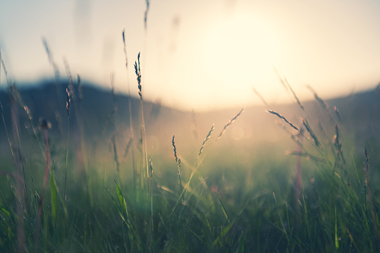
Where does REGULATION come from?
Our bodies
Our brains
Our bodies are designed to keep us safe, strong and surviving. We need nourishment and we seek comfort – homeostasis.
Our brain has stories about what is happening – positive and negative. Positive stories about events keep us regulated.
Our emotions
Our parents
We also have lots of emotions – some primitive – that tell us what we need. We learn what is ‘normal’ when experiencing emotions like grief.
Our self-regulation comes when we have been helped to regulate. When our parents model being calm around spiders, we are more likely to be calm around spiders!

Slide 4

How does self-regulation develop?
By co-regulation
Explicit teaching
We learn to regulate when we feel safe and our care-givers respond to our regulation need. Before we talk about feelings, we need to experience them.
Emotion Coaching can be used to ‘name it, to tame it’ (Dr Tim Bryson). Sometimes children need to learn in the moment what the feeling is before they can manage it.
By reflection
Through stories
Comic strip stories, looking at the thoughts, feelings and actions in a moment help to develop strategies for regulation.
Every story has an opportunity to talk about feelings and how to respond. Self—regulation and empathy can develop together through an emotional vocabulary.

Slide 5
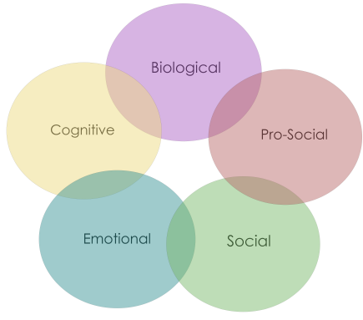
What is dysregulation?
Signals dysregulate us.
Some are the same for everyone – most school children care about not being responded to when hurt.
Sometimes the focus on dysregulation can be those that demonstrate the most extreme externalising behaviours, not those with the greatest SEND.
Some people do not read their own signals in the same way – there is research around people with Autism experiencing ‘feelings’ differently from neurotypical peers.
Some signals can send us into ‘fight, flight, fright, freeze’.

Slide 6
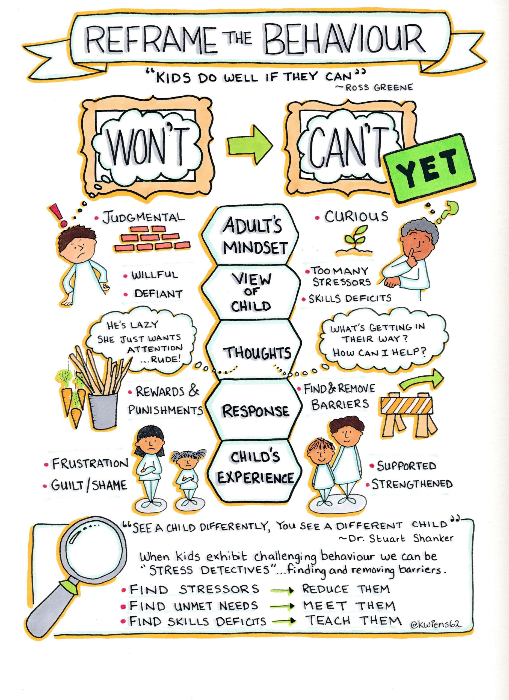
What do we see?
Being objective is hard!
See the need, meet the need.
What do we think?
What do you believe of your child? What is your reaction to the behaviour? Why?
Boundaries
Safe boundaries are good for children, this is not about letting them do anything they want! Discomfort is sometimes necessary.

Slide 7
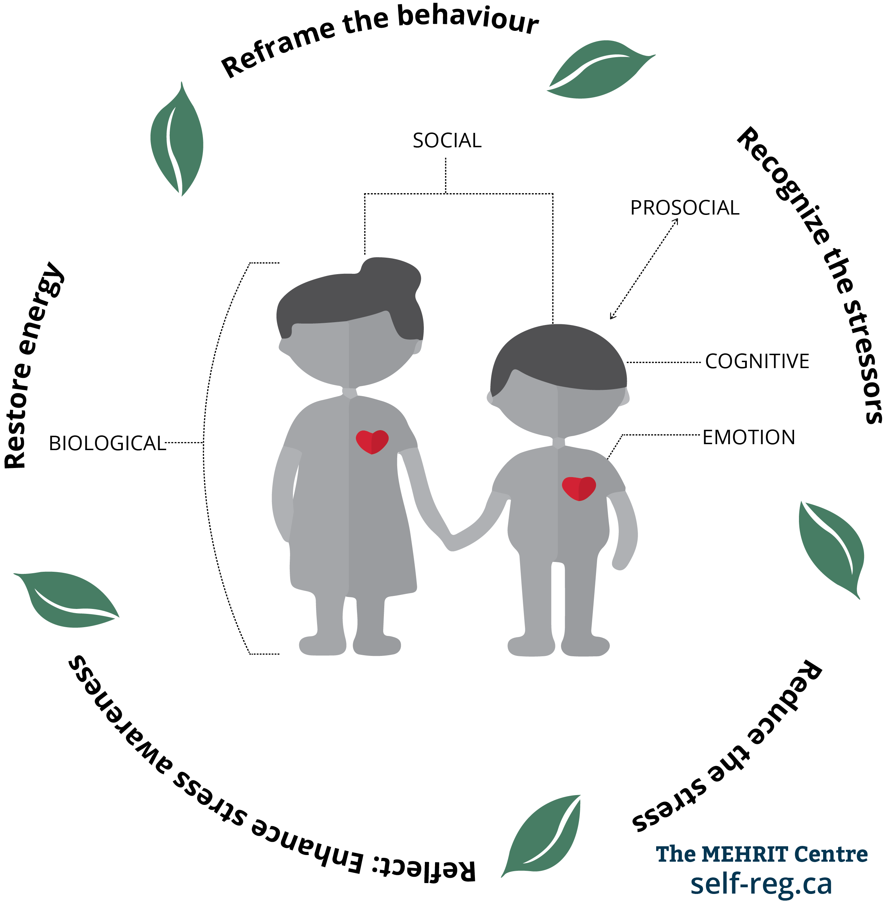
Dr Stuart Shankar
Sometimes, when we recognise the stressors the strategy for reducing the stress may cause a knock-on dysregulation.
For example, if a child is finding social skills hard and is removed from learning to practice them, what happens to their cognitive stresses?

Slide 8

Zones of regulation
Happy, calm, safe, ready to learn
Green
Green does not mean that school is the happiest place for us, but that we are happy enough to learn. Content. Settled.
Not green: Blue, Yellow, Red (positive and negative)
Sometimes different emotions feel the same but are just needing to be named better, like anxiety and excitement.

Slide 9
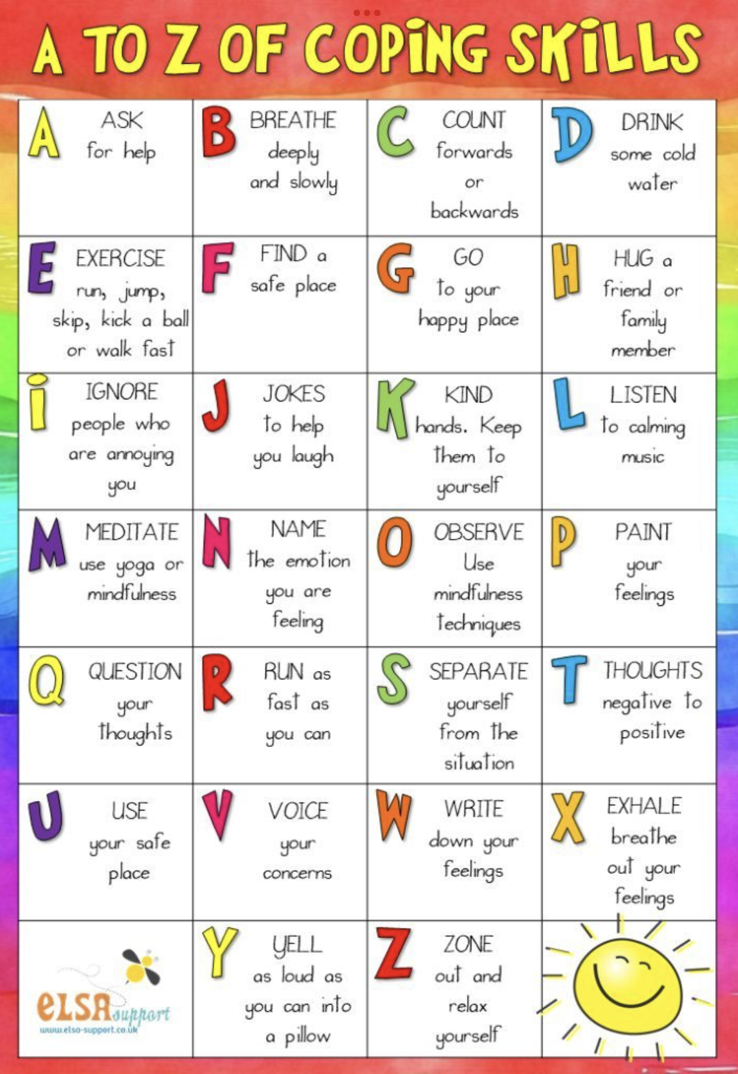
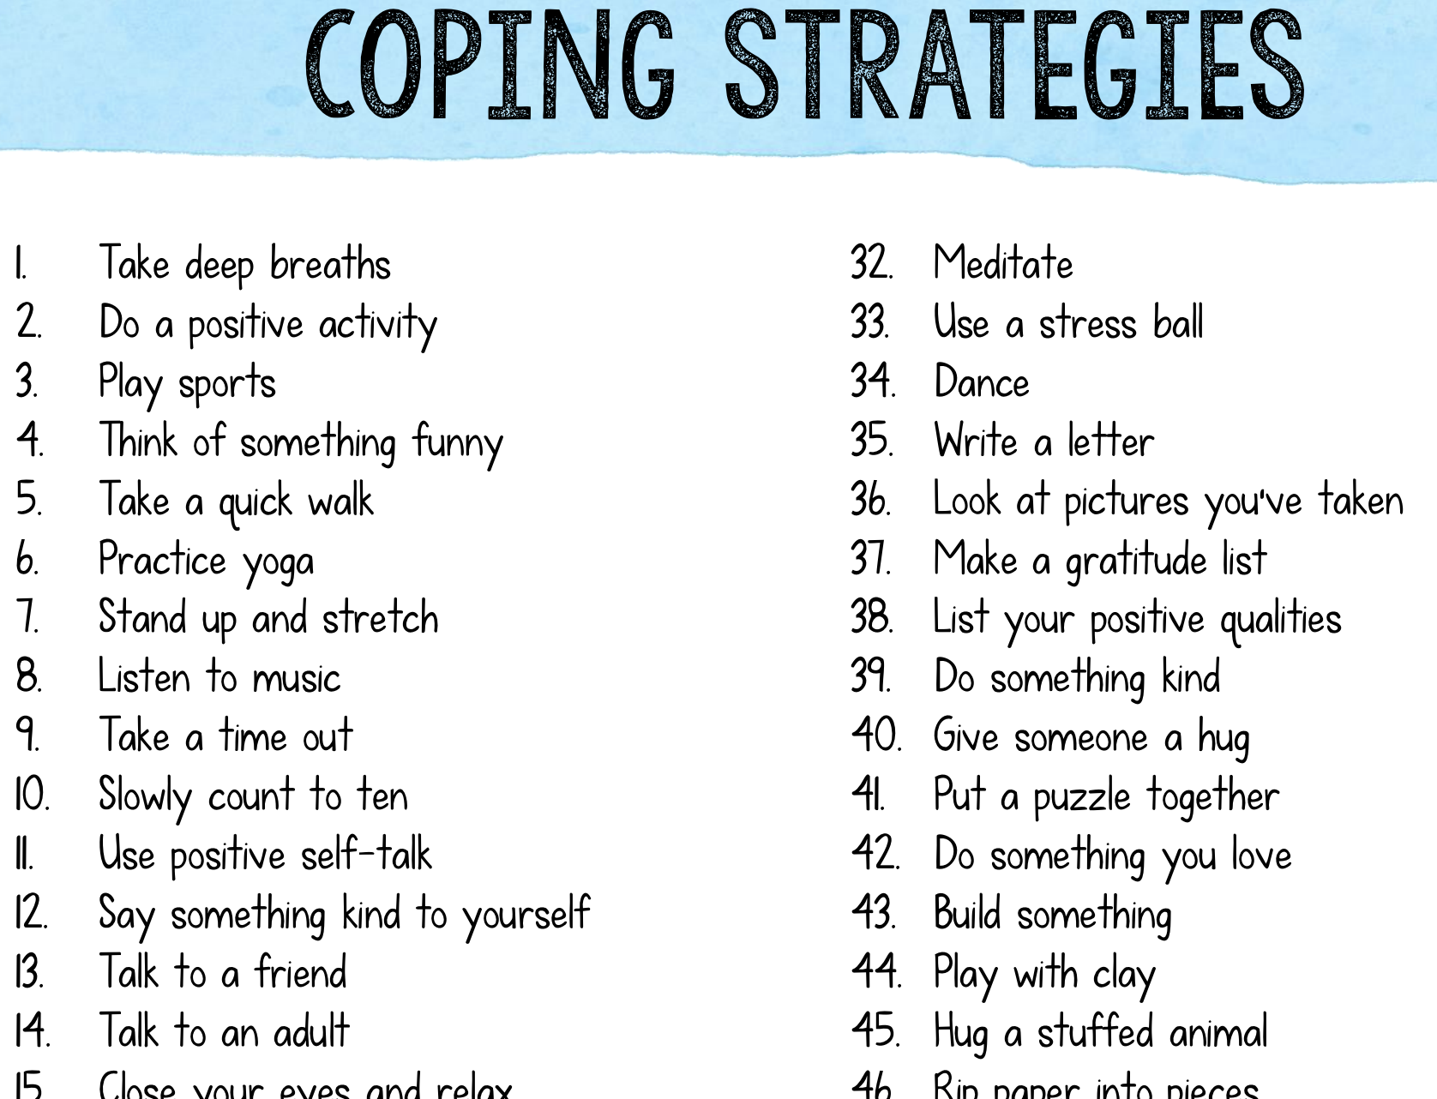
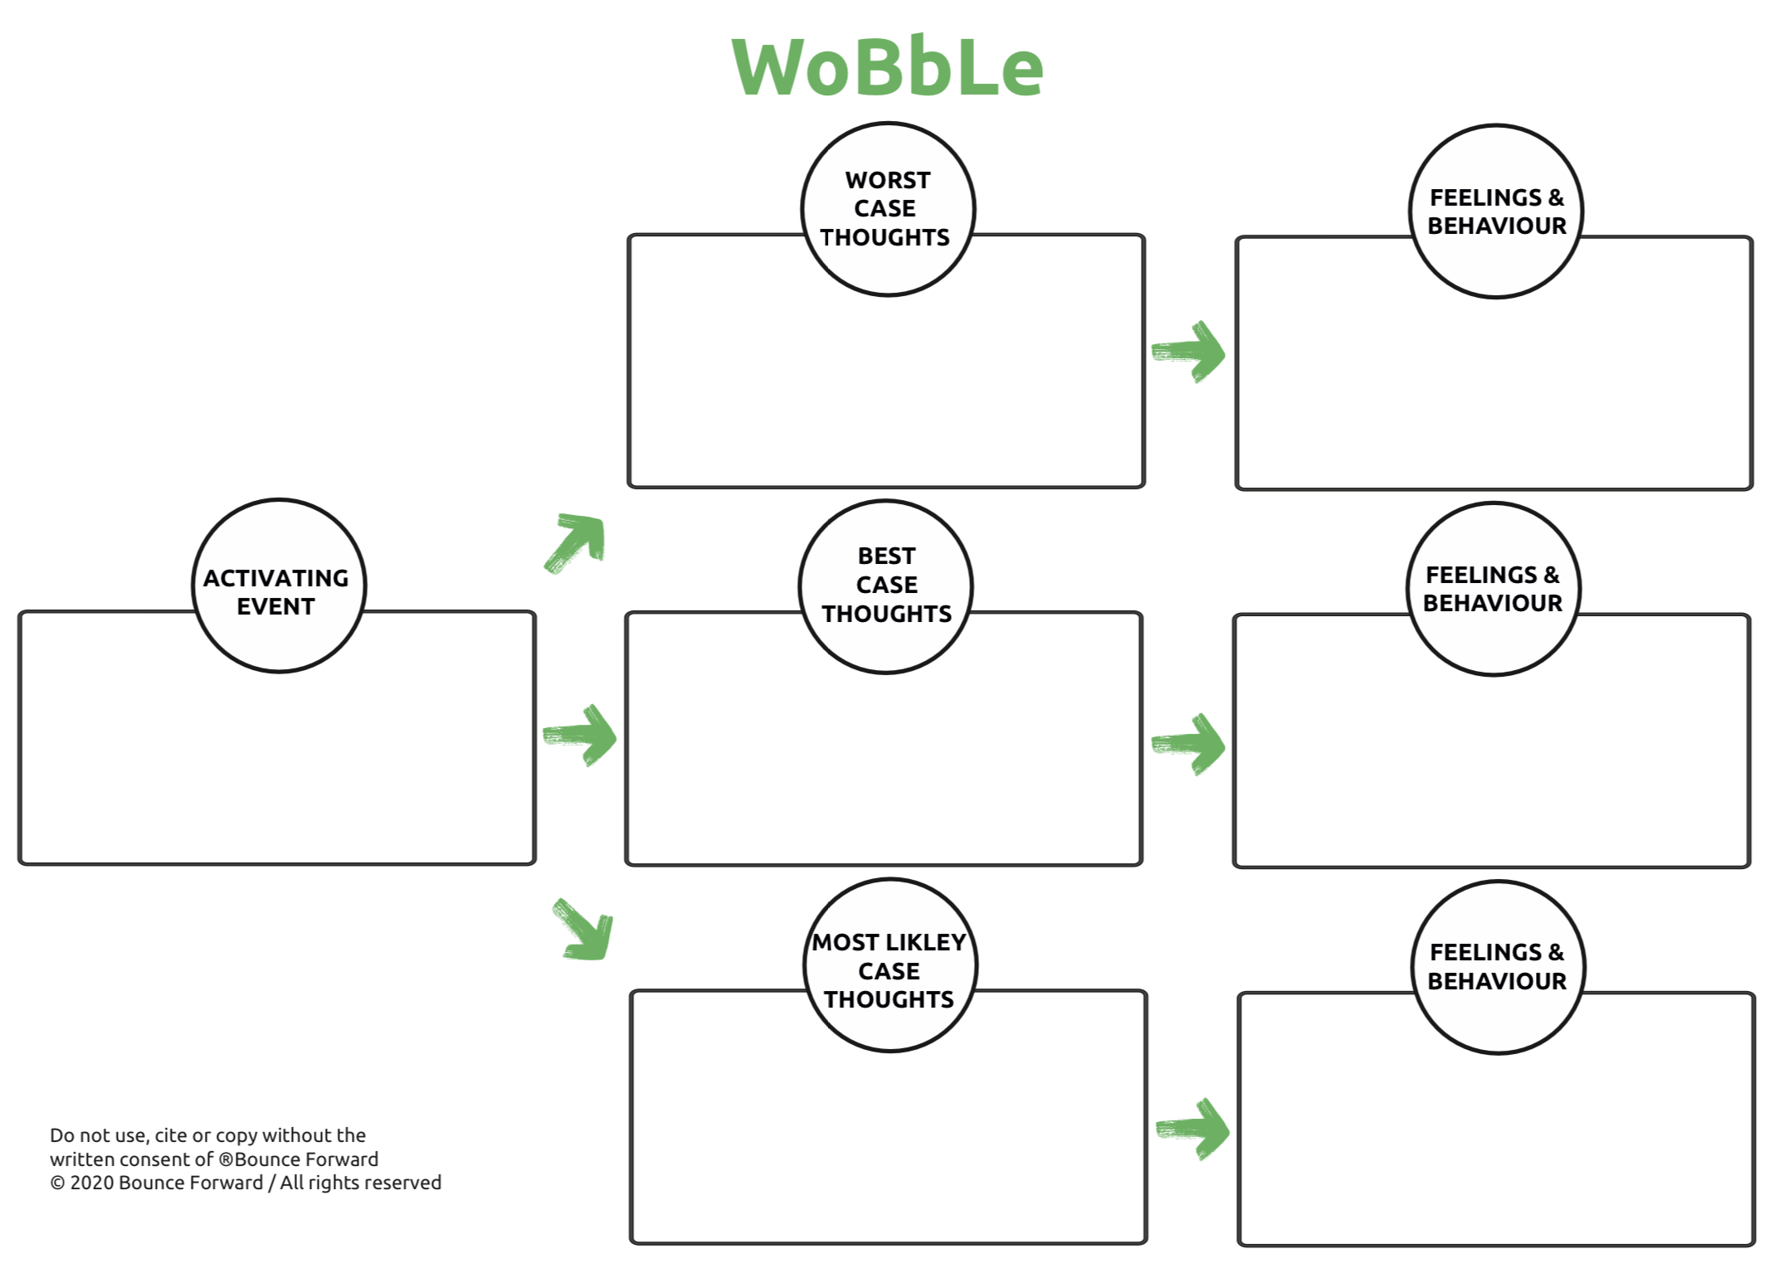
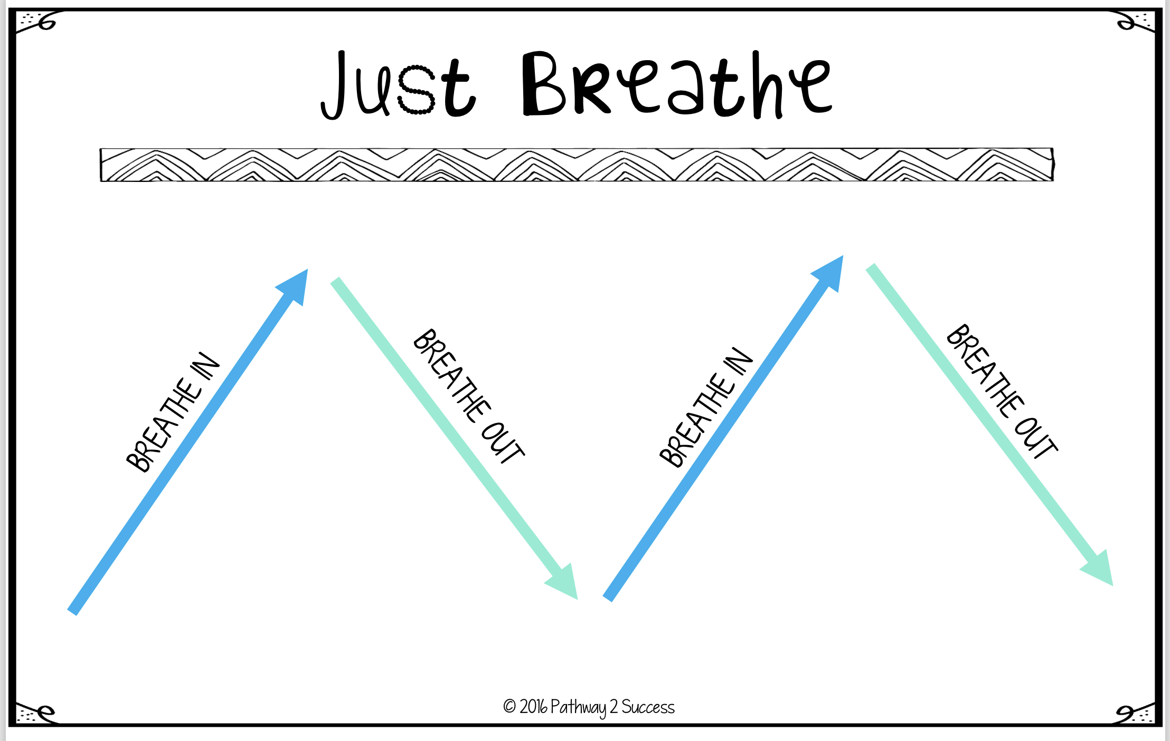
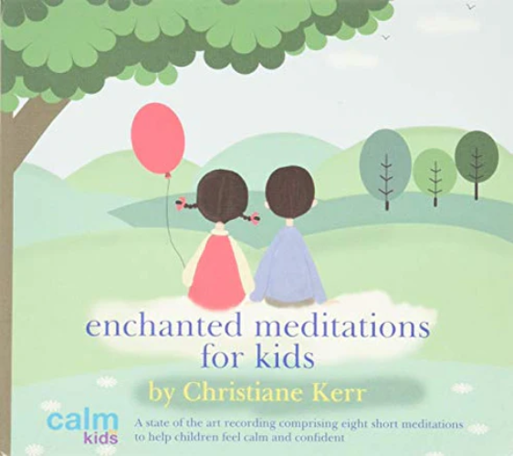

Slide 10
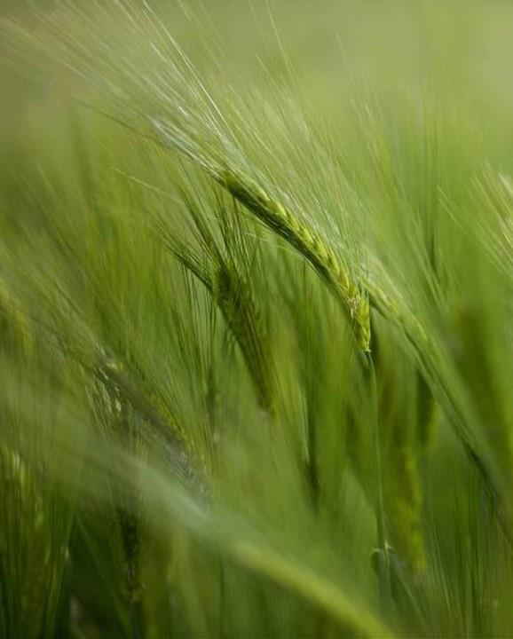
5 ways to wellbeing
NHS research led practices
Be Kind
Learn
Be Active
Be mindful
Connect

Slide 11
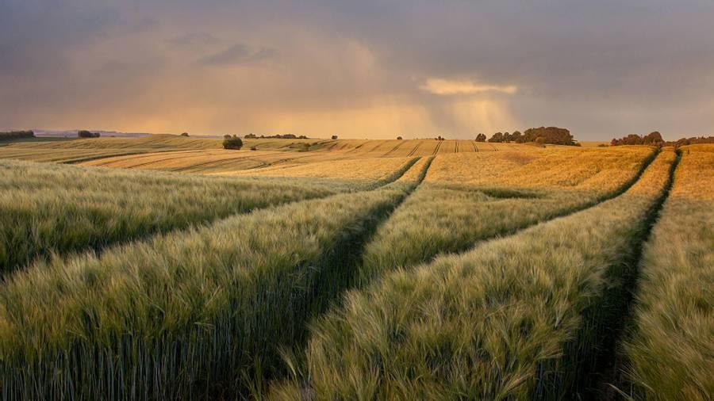
Superpowers
There’s a place for every skill

Slide 12

Our children are doing the best they can right now.
Talk
What we say and how we say it leaves a feeling. Sometimes a memory of who we say our children are.
I wonder…
Be curious with children’s feelings (and with your own). What made that an emotional time? (PACE approach)
Work on your own Well-Being
You can’t pour from an empty cup. ​

Slide 13
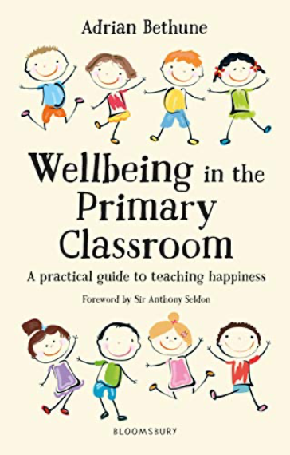
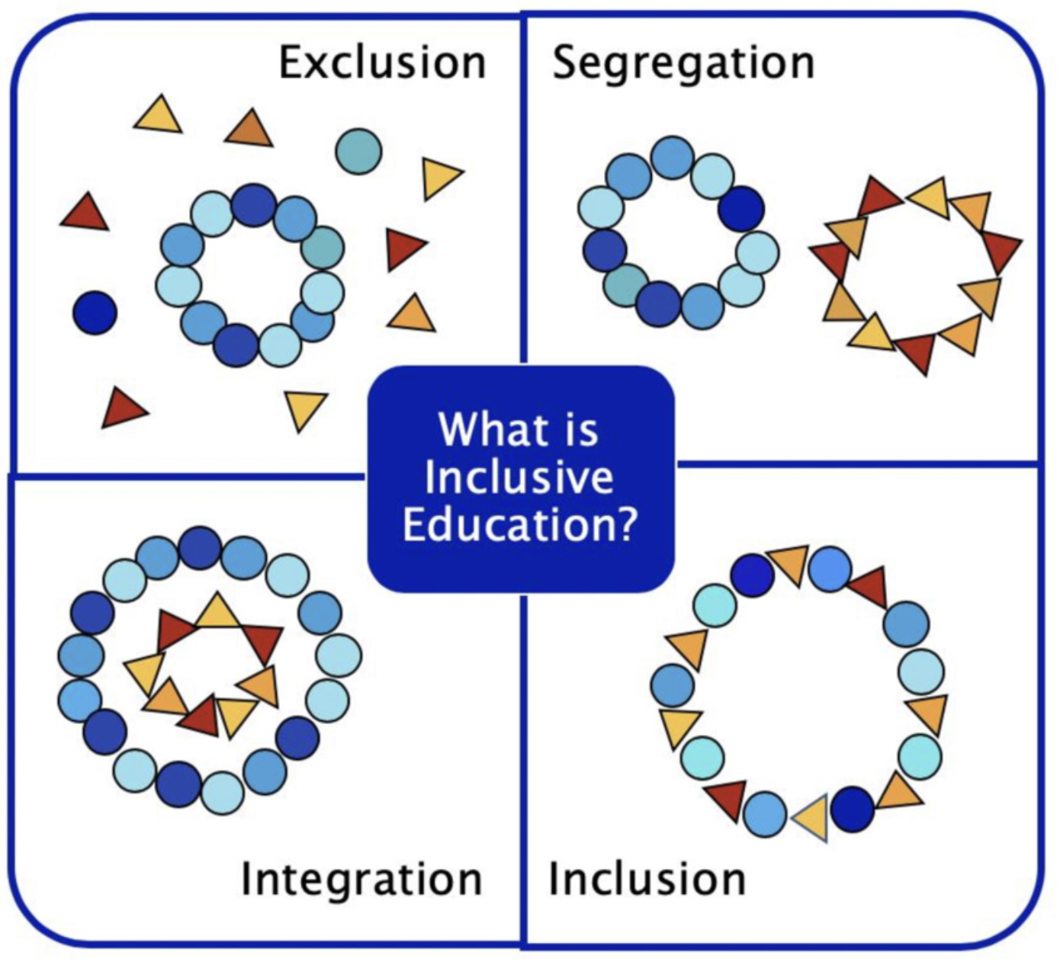
Wellbeing in the primary classroom
Systemic change to support regulation
Staff wellbeing
Promoting pro-social, social, emotional and physical/biological needs
By building on successes and remembering the positives, the stories we tell ourselves (see the work of Brene Brown) help us to create professional confidence. (See Peps McCrae…)
Bethune is an advoacte of part time working to support mental health, if that is what is needed to create good work/life balance.
Adrian Bethune is an advocate of holistic education. His book is research and experienced based, starting with building a tribe ready to work together.

Slide 14

Thank you
Amy Schofield
amyhschofield@gmail.com

Slide 15

References:
Whole Brain Child: Dr Tina Payne Bryson and Dr Dan Siegel
Raising Humans: Ross Greene
The Book you wish your parents had read: Philippa Perry
Daring Greatly: Brene Brown
How to talk so little kids listen and listen so little kids talk: Joanna Faber and Julie King
Wellbeing in the Primary Classroom: Adrian Bethune
Emotion Coaching UK
Mine Conkbayir
NHS
Big Life Journal
Online: Dr Shaun Shankar

